Slide 1
Presentation on Multimedia and the Web
Prepared by:
Apson Kunwar
Bikas Bhatta
Nabin Upreti

Slide 2
Introduction
Derived from the word “Multi” and “media”
Multi
Many, multiple
Media
Distribution tools and information presentation: text, audio, video, animation, graphics, etc.

Slide 3
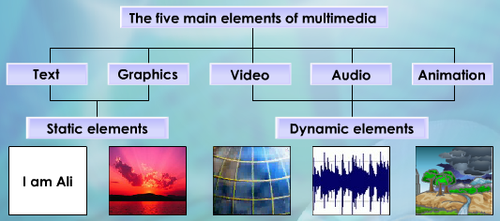
Elements of Multimedia
Text
Graphics
Audio
Video
Animation

Slide 4
Elements of Multimedia
Text
basic element of multimedia, involves the use of text types, sizes, colors and background colors
mostly use for titles, headlines, menu, paragraph, list etc.
software for viewing text files are Microsoft Word, Notepad, Word pad etc.
Graphics
digital representation of non-text information, such as a drawing, chart, or photograph.
make the multimedia application attractive
help to illustrate ideas through still pictures

Slide 5
Elements of Multimedia
Video
technology of electronically capturing, recording, processing, storing, transmitting, and reconstructing a sequence of still images representing scenes in motion
Photographic images that are played back at speeds of 15 to 30 frames a second and the provide the appearance of full motion.
Common file types for Video include AVI, WMV, FLV, MOV, MP4
Audio
related with recording, playing etc.
increase the understandability and improves the clarity of the concept
includes speech, music or any other sound

Slide 6
Elements of Multimedia
Animation
rapid display of a sequence of images of 2-D artwork or model positions in order to create an illusion of movement
an optical illusion of motion due to the phenomenon of persistence of vision, and can be created and demonstrated in a number of ways.
Entertainment multimedia titles in general, and children’s titles specifically, rely heavily on animation

Slide 7
Web Based Multimedia
the multimedia found within web pages
display information requested by the user through hyperlinks
often used in advertisements, informational videos of available products offered by companies, or as “user- generated content”, such as videos uploaded to YouTube
it can make information more enjoyable and interesting to a user
implemented in order to spice up a web-page

Slide 8
Application of Multimedia
Multimedia in Education
Teacher deliver course content using different multimedia
Help student for clear concept and understanding
Multimedia in research
, multimedia is mainly used for modeling and simulation
Multimedia in Entertainment
Movies
debugging editing mixing give best output
Games

Slide 9
Application of Multimedia
Multimedia in Business
Video conferencing
Marketing and advertisement
give the product information to their customers
newspaper, radio, online, television
Multimedia in medicine
doctors can get trained by looking at a virtual surgery
simulate how the human body is affected by diseases
techniques to prevent diseases

Slide 10
Advantages of Multimedia
Increases learning effectiveness :
uses images, audio, animations and other media which stimulates the brain and increases learning
Students can identify and solve various problems effectively using multimedia
Improves personal Communication :
increases communication efficiency, effectiveness and potential to communicate message or information
Reduces training costs :
reduces the time it takes to learn and thereby it reduces cost
can reduce the cost of training department in various ways.
Easy to use :
Multimedia is making easier the things let they can easy understand.
Content is easy to draft using different types of multimedia.

Slide 11
Disadvantages of Multimedia
Misuse of Multimedia :
difficult for teachers to monitor students, some students may play games or surfing web pages and may not focus on their studies
Lost in cyberspace :
People may waste their time on surfing unnecessary information on internet and may not focus on important issues
Non Interactive :
Teachers teaching students may be more interactive compared to videos or internet teaching students
Time consuming :
Effective multimedia content takes time while creation.

Slide 12
Multimedia in Business
Today multimedia is very important to promote any time of business easily and effectively.
Multimedia devices such as mobile phones, laptops etc. plays and important role to grow business.
Millions of websites on internet reach end user and grow business.
Using multimedia anyone can sell their product anywhere in the world on internet.
By placing Ad in magazines and newspapers business can be increased effectively.
millions of people watches videos, share product with them within seconds
Advertising industry uses multimedia for marketing various products.
Various companies making Virtual Games uses multimedia and makes it more attractive.

Slide 13


Thanks!

